Slide 1
Emotion (Valence and Arousal) Prediction from DEAP Dataset
Mr. Jirasak Buranathawornsom
Mr. Arnajak Tungchoksongchai
Mr. Sunny Kumar Tuladhar
Mr. Amanda Raj Shrestha

Slide 2
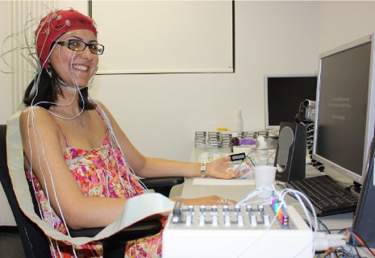
Objective
Try to predict the Emotion from DEAP dataset using various features and machine learning methods.

Slide 3
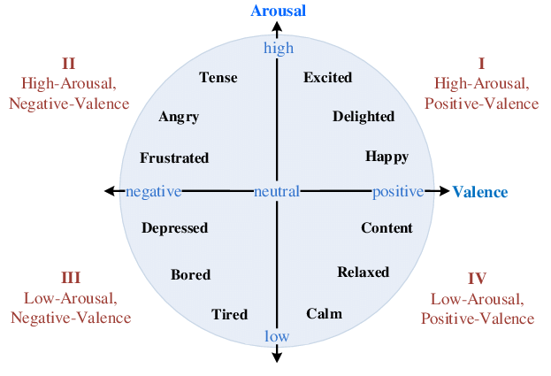
About the DEAP Dataset
A database for Emotion Analysis using Physiological Signals.
Main Goal of the dataset to create an adaptive music video recommendation system. Uses Valence-Arousal Scale by Russell for emotion categorisation

Slide 4
Valence and Arousal

Slide 5
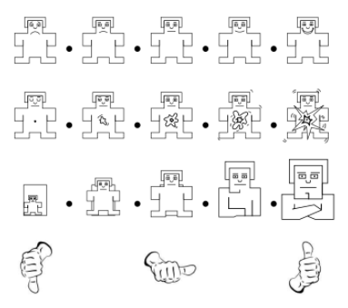

UI filled by participants
VALENCE
Major predictors of emotion
AROUSAL
DOMINANCE
LIKING

Slide 6
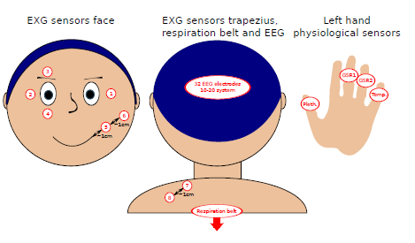
About the dataset
32 participants. 32 EEG electrodes (10-20 system) sampled originally at 512 Hz and 8 peripheral physiological signals recorded.
40 videos(stimuli) of 1 minute each shown to each participant with a break after 20 mins.
Videos were music videos selected on basis of LALV/LAHV/HALV/HAHV and other many criterias of excitement.
Placement of peripheral physiological sensors.
For Electrodes were used to record EOG and 4 for EMG
(zygomaticus major and trapezius muscles). In addition,
GSR, blood volume pressure (BVP), temperature and
respiration were measured.

Slide 7
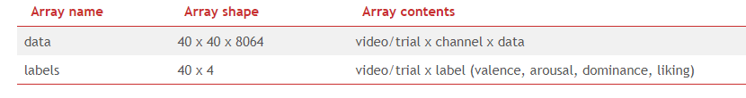
About the dataset (Preprocesssed)
The data was downsampled to 128Hz from 512 tto 256 and then to 128.
EOG artefacts were removed. electrooculogram (EOG) represents the eyeblinking signals
A bandpass frequency filter from 4.0-45.0Hz was applied.
The data was averaged to the common reference.
The EEG channels were reordered so that they all follow the Geneva order as above.
The data was segmented into 60 second trials and a 3 second pre-trial baseline removed. 63 x 128 = 8064
The trials were reordered from presentation order to video (Experiment_id) order.

Slide 8
Experiments
Power Spectral Density (PSD) + Machine Learning(SVM, NVB, KNN, XGBoost)
Power Spectral Density (PSD) + ANN
Short Term Fourier Transform + 3dCNN

Slide 9
PSD using Welch’s Periodogram
Power Spectral Density was extracted from the signal. Our signal is sampled at 128 Hz and has a band pass at 4.0-45.0Hz .
The original array is 32 subjects x 40 clips x 40 channels x 8064 channels.
This was converted to first to 32sub x 40 clips x 32 eegchannels x 7680 signals
(first 3 seconds are baseline so 3 x 128 were removed)

Slide 10
The brainwave frequencies
Theta brainwaves (4-7 Hz) represent a day dreamy, spacey state of mind mental inefficiency. At very slow levels, theta brain wave activity is a very relaxed state, representing the twilight zone between waking and sleep.
Alpha brainwaves (8-12 Hz.) are slower and larger. Associated with a state of relaxation and represent the brain shifting into an idling gear, waiting to respond when needed. If we close our eyes and begin picturing something peaceful, there is an increase in alpha brainwave
Beta brainwaves (13 – 38 Hz) are small, faster brainwaves associated with a state of mental, intellectual activity and outwardly focused concentration. This is basically state of alertness.
Gamma brainwaves (39 – 42 Hz) are the fastest and most subtle brain waves. Gamma rhythms modulate perception and consciousness.

Slide 11
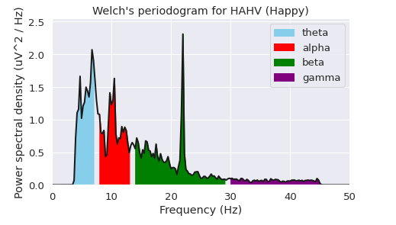
Power Spectral Density
Each channel was converted to the band power of each of these frequencies. A window of 4 seconds was chosen for the PSD extraction.
Welch’s periodogram for the 1st channel of the first person’s 1st video.

Slide 12
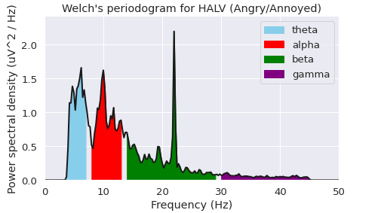
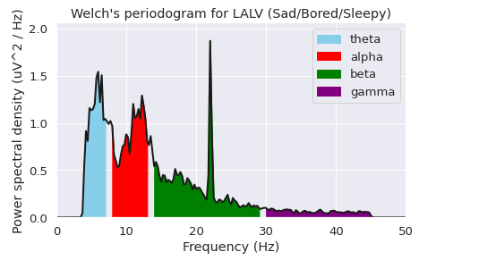
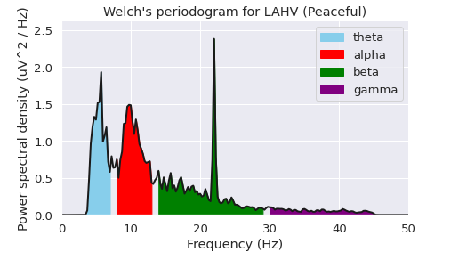
Periodogram for the 1st subject in the 1st channel of four clips that caused four emotions

Slide 13
PSD + Machine Learning
Data was split into 25 Train subjects and 7 test subjects.
Then 4 freq power bands were extracted from the signal.
First each isolated power band from the 32 channels was taken as the feature separately and fed into ML algorithms(SVM, NVB, KNN, XGBoost)

Slide 14
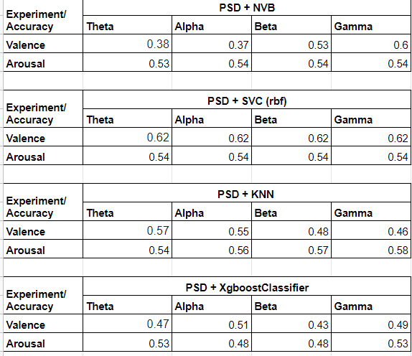

Slide 15
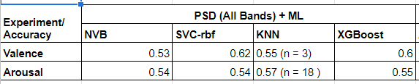
PSD all bands + ML
Later all 4 bands of each of the 32 channel (32 x 4 = 128 features) was fed into the ML algorithms.

Slide 16
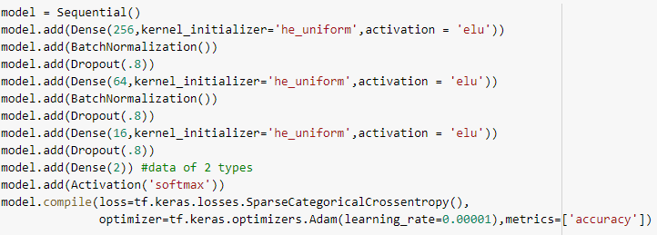
PSD + ANN
Next the PSD with 128 features was run through this Neural Network

Slide 17
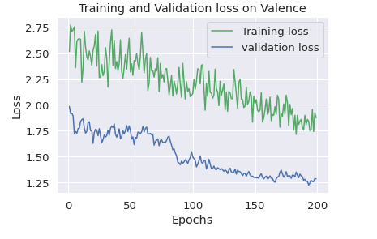
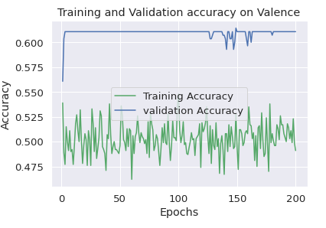
PSD + ANN on Valence
Final validation accuracy on Valence was 0.61 after 200 epochs

Slide 18
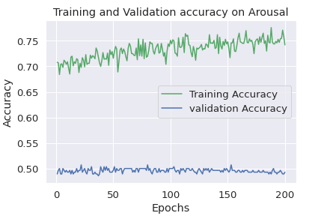
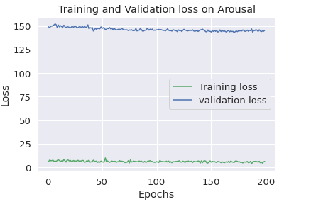
PSD + ANN on Arousal
Final validation accuracy on Arousal was 0.49 after 500 epochs

Slide 19
PSD Conclusion
From the above results we have see that PSD of band features combined with Machine Learning does not perform well in predicting Valence and Arousal with single or all of the frequency bands.
KNN seems to be performing the best among them with 0.56 and 0.63 accuracy.
It could be due to lack of temporal data in the extracted features and that emotion is temporal. Possibility.
So next we try STFT with 3dCNN

Slide 20
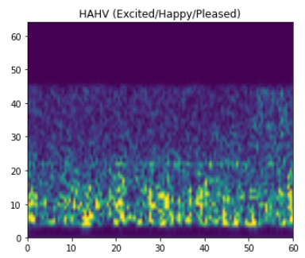
Short Term Fourier Transform
Next STFT was performed on all 32 EEG channels with a window of 4 secs, 512 samples as recommended by this.

Slide 21
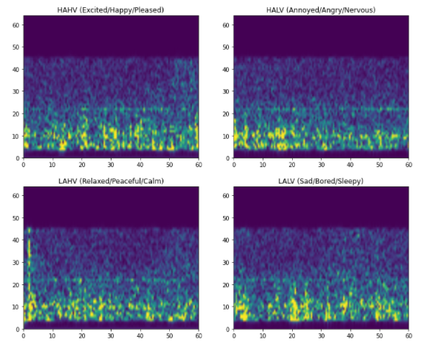
Spectrogram visualisation of 4 emotions of same subjects when watching 4 different clips of channel 5.

Slide 22
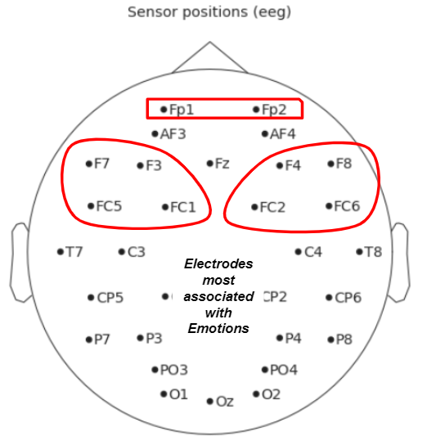
10 electrodes for Emotion
Next 10 electrodes were selected based on this paper which were most associated with emotion

Slide 23
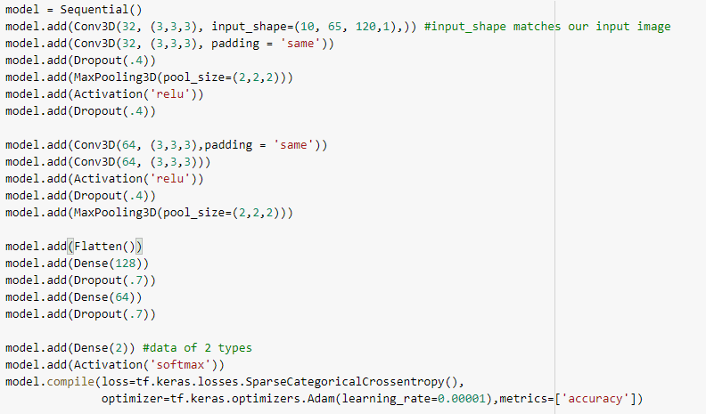
STFT + 3dCNN
Next we feed the spectrogram image 65 x 120 into a 3DCNN. Our input shape is 32chan x 65 x 120 x 1.

Slide 24
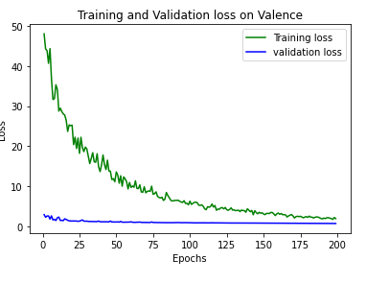
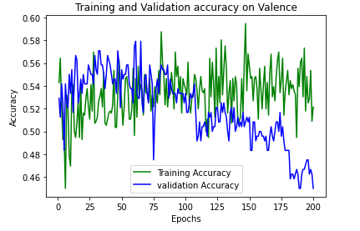
STFT + 3dCNN (Valence)

Slide 25
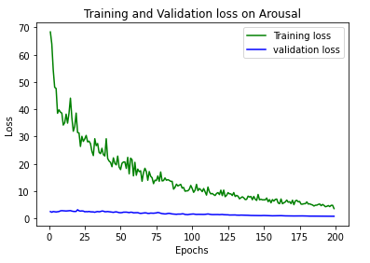
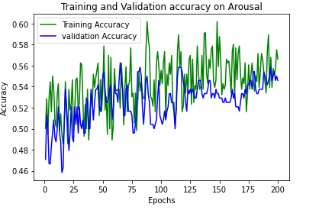
STFT + 3dCNN (Arousal)

Slide 26
STFT+3dCNN Conclusion
It seems that even with STFT and temporal data the model is not performing well. More research, other methods of feature extraction and different models could be tried to get better results
Also combining the Valence and Arousal into one emotion label with HAHV, HALV, LAHV and LALV as the 4 classes in the label could also be tried out.

